Slide 1
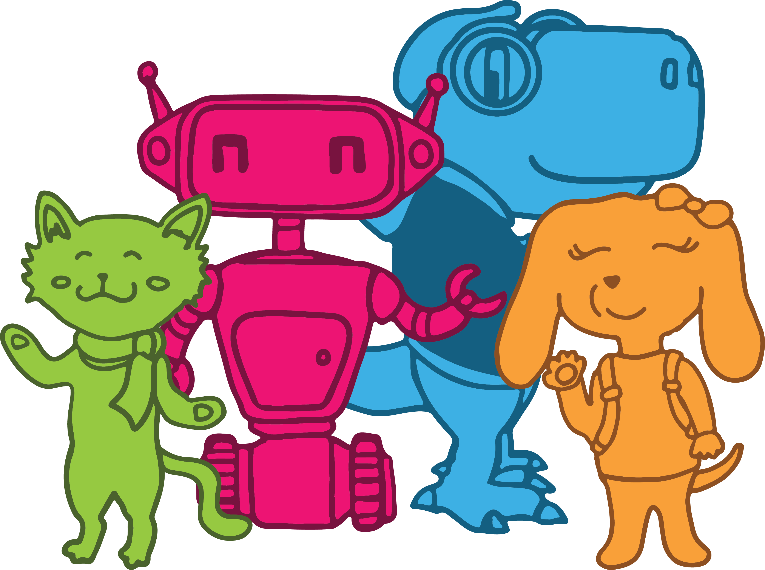
Welcome!
Vaccination Clinic
This way

Slide 2
Welcome!
Vaccination Clinic
This way

Slide 3
Welcome!
Vaccination Clinic
This way

Slide 4
Vaccination waiting area
Scan for
activities

Slide 5
Vaccination waiting area
Scan to
Play games

Slide 6
Vaccination waiting area
Visit cardsystem.ca
For activities & games

